Slide 1
TRAVILAGO
A Tour booking Website, book unforgettable tours and discover unexplored places
Sashank Machiraju
Saketh Sai Mallepaddi
Saipranath Gopathi
Priyadarshini Karaddi
Suhasini Polampelly

Slide 2



Problem Statement
Popular destinations dominate tour booking websites, leaving unique and authentic experiences undiscovered.
This focus causes travelers to miss out on incredible but lesser-known destinations.
Limited accessibility and information on unexplored destinations is a major concern for travelers.
A platform for booking tours to unexplored places can help travelers discover new, exciting, and sustainable destinations.

Slide 3
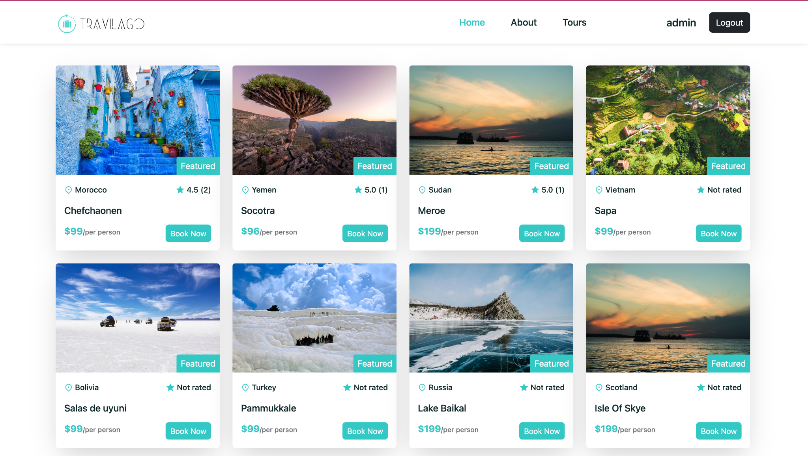
How are we Solving this?
We offer tours to lesser-known and unique destinations, providing access to unexplored travel experiences.
Our platform works with local tour operators to create sustainable and responsible tour packages and offers detailed destination information for easy travel planning.
.

Slide 4

Tech Stacks Used

Slide 5
Basic Flow
Landing Page
Log In
No
User Exists?
Yes
Log In
Authenticated?
No
Yes
Register
Pages & Tours

Slide 6


Pages
Login and Register

Slide 7
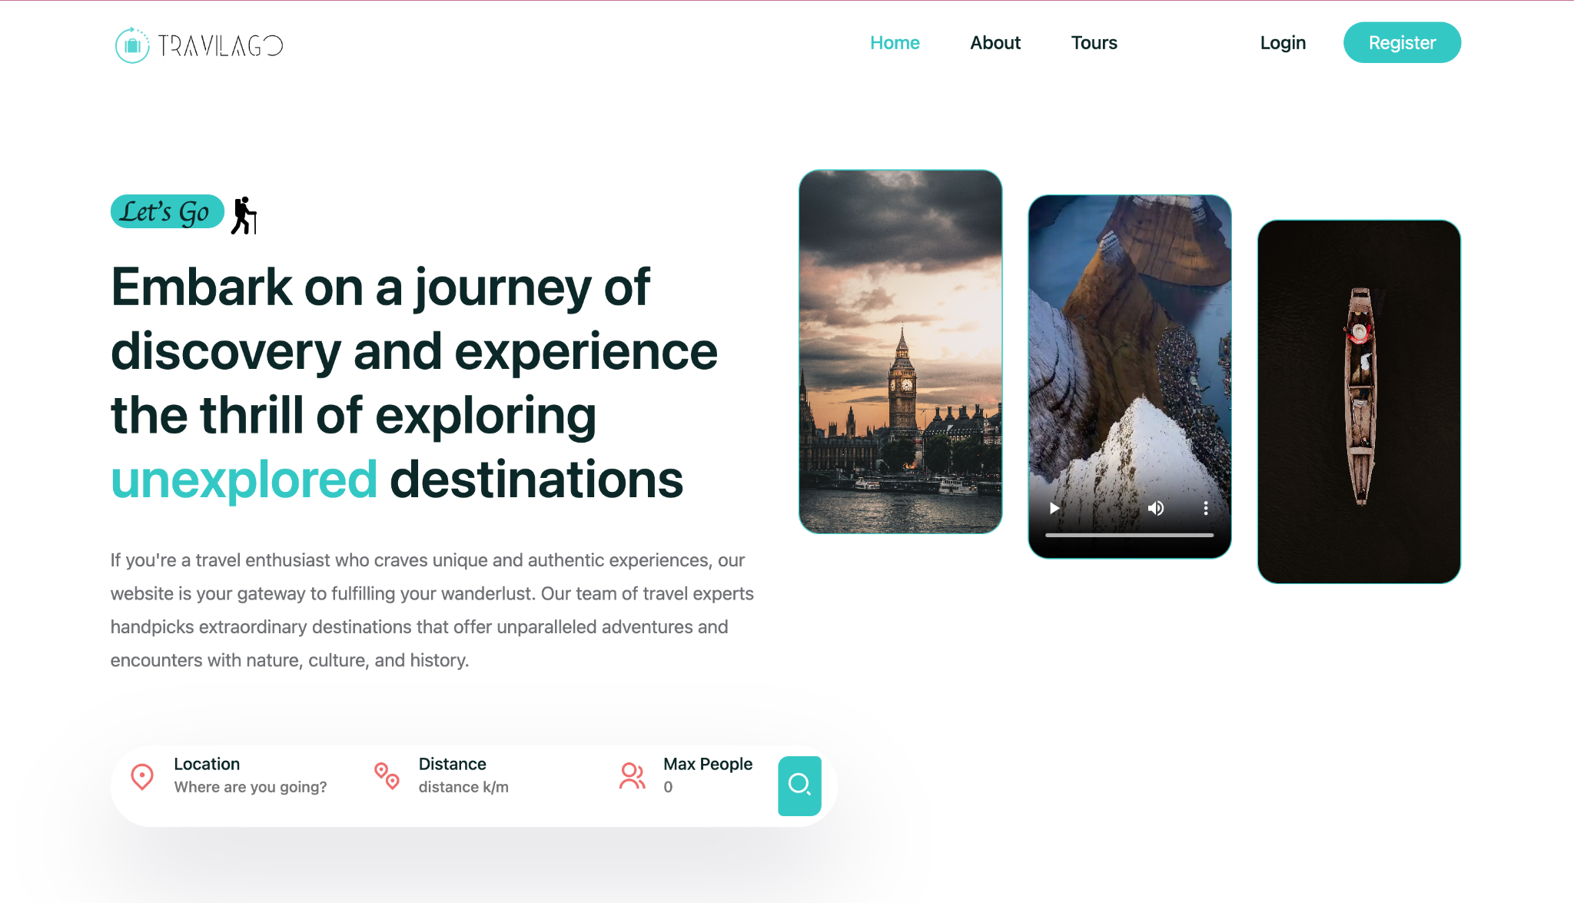
Pages
Home

Slide 8
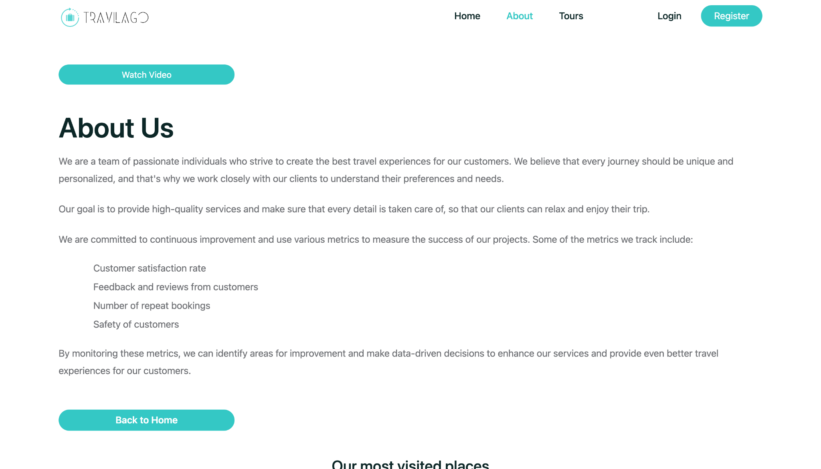
Pages
About

Slide 9
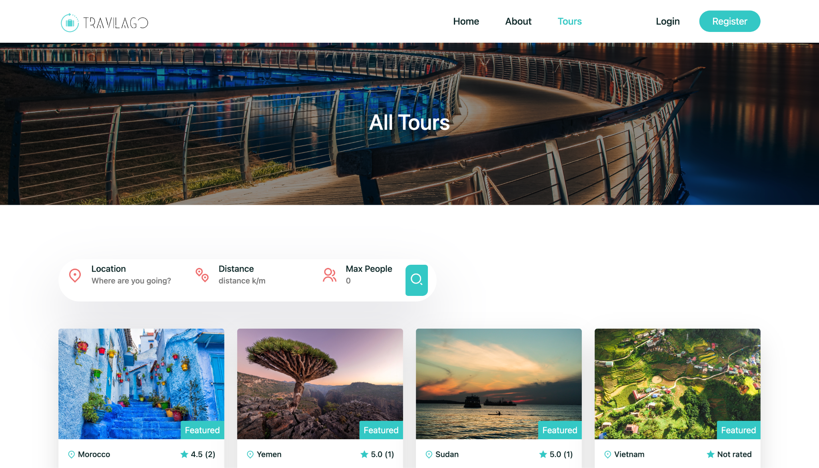
Pages
Featured Tours

Slide 10
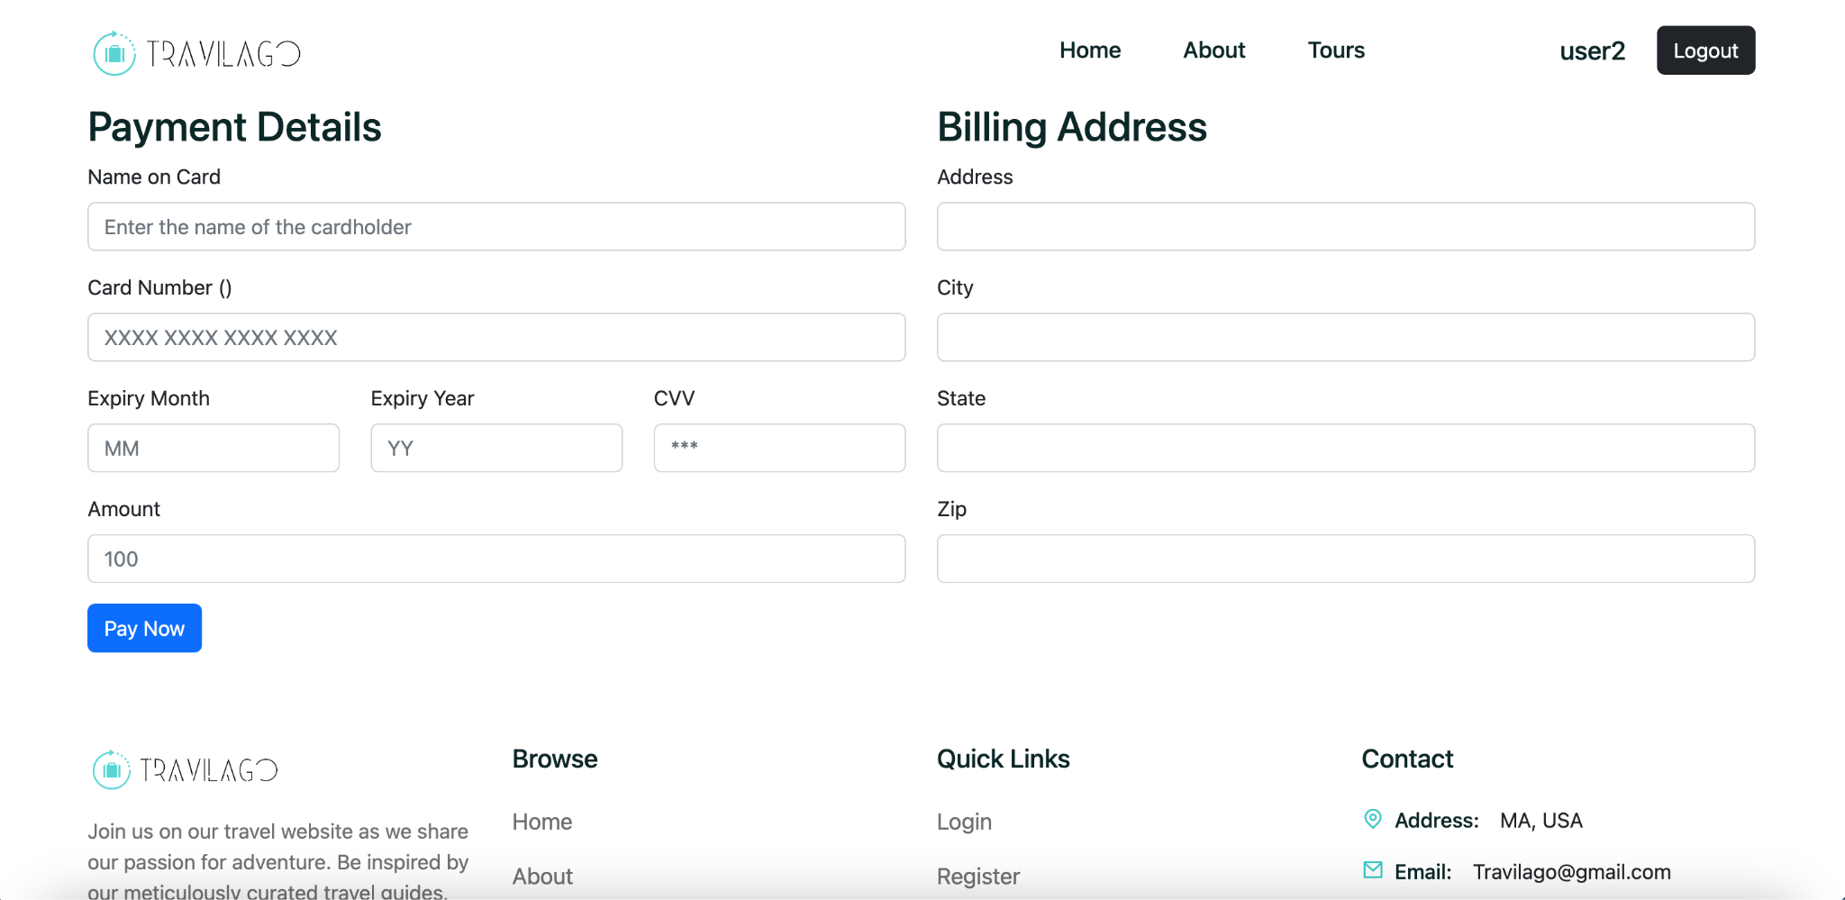
Pages
Payment Page

Slide 11
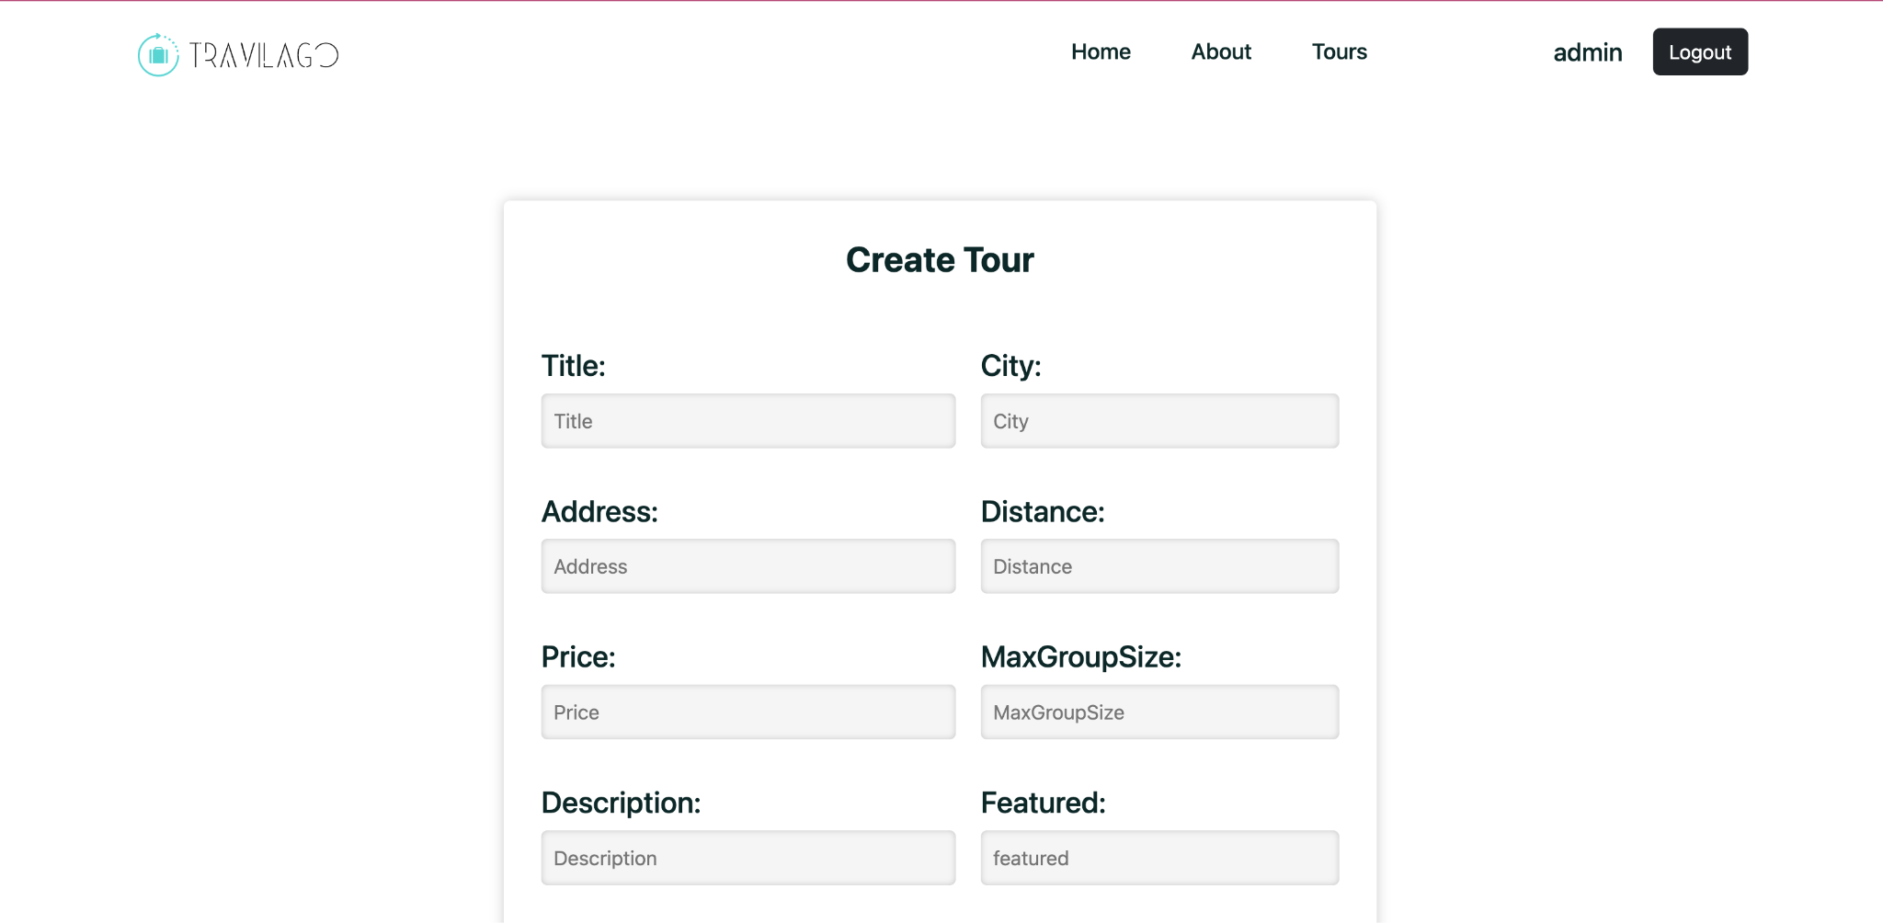
Pages
Admin Page

Slide 12
THANK YOU

